Slide 1

Chapter 9: Simply Typed Lambda-Calculus
Function Types
The Typing Relation
Properties of Typing
The Curry-Howard Correspondence
Erasure and Typability

Slide 2

Function Types
T1→T2
classifying functions that expect arguments of type T1 and return results of type T2.
(The type constructor → is right-associative.
T1→T2→T3 stands for T1→(T2→T3) )
We will consider Booleans with lambda calculus
T ::= Bool
T → T
Examples
Bool→Bool
(Bool→Bool) → (Bool→Bool)

Slide 3
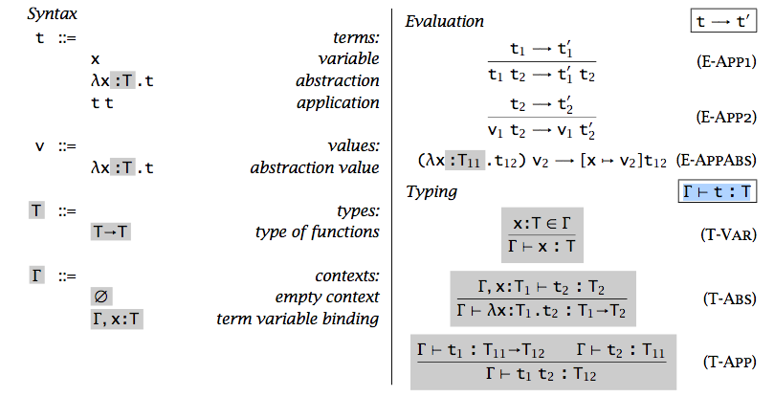

λ→
Assume all variables in Γ are different
Renaming if some are not

Slide 4
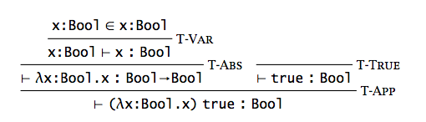

Type Derivation Tree

Slide 5
Properties of Typing
Inversion Lemma
Uniqueness of Types
Canonical Forms
Safety: Progress + Preservation

Slide 6
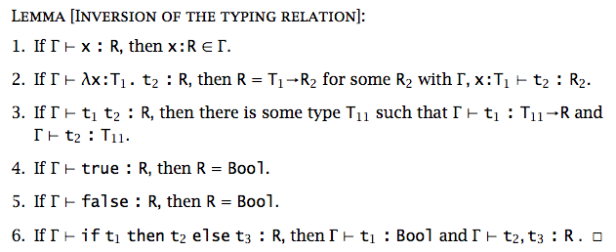

Inversion Lemma
Exercise: Is there any context Γ and type T such that Γ ⊢ x x:T?
Notes:
No, as x will have two types

Slide 7
Uniqueness of Types
Theorem [Uniqueness of Types]: In a given typing context Γ, a term t (with free variables all in the domain of Γ) has at most one type. Moreover, there is just one derivation of this typing built from the inference rules that generate the typing relation.

Slide 8
Progress
Theorem [Progress]: Suppose t is a closed, well-typed term. Then either t is a value or else there is some t′ with t → t′.
Proof: By induction on typing derivations.
Closed: No free variable
Well-typed: ⊢ t : T for some T

Slide 9

Preservation
Lemma [Preservation of types under substitution]: If Γ, x:S ⊢ t:T and Γ⊢s:S,
then Γ⊢[x→s]t:T.
Proof: By induction on derivation of Γ, x:S ⊢ t : T.
Theorem [Preservation]:
If Γ⊢t:T and t →t′, then Γ ⊢t′ :T.

Slide 10
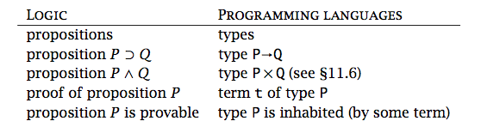

The Curry-Howard Correspondence
A connection between logic and type theory

Slide 11
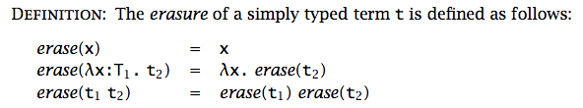
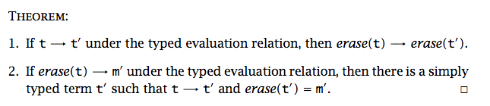

Erasure and Typability
Types are used during type checking, but do not appear in the compiled form of the program.
Untyped?

Slide 12
Curry-Style vs. Church-Style
Curry Style
Syntax → Semantics → Typing
Semantics is defined on untyped terms
Often used for implicit typed languages
Church Style
Syntax → Typing → Semantics
Sematnics is defined only on well-typed terms
Often used for explicit typed languages

Slide 13
Homework
Read Chapter 9.
Do Exercise 9.3.9.

